Slide 1

A Presentation on
Evolution of Service Marketing
By
Raminder Pal Singh Arora
Assistant Professor
Graduate School of Business
Tula’s Institute, Dehradun
Tula’s Institute, Dehradun

Slide 2
Evolution of service marketing
The ‘Crawling Out’ stage which took place prior to 1980
The ‘Scurrying About’ stage between 1980 and 1986
The ‘Walking Erect’ between 1986 and 2000.
The ‘Galloping’ stage from 2000 till date.

Slide 3
‘Crawling Out’ Stage(prior to 1980)
Marketing traditionalists argued that service organizations did not need a separate body of theory, and that existing marketing theories could, and should, be applied to service organizations.
They argued that services could not be defined tightly enough to deserve special treatment and, in many instances, were so closely linked to the physical product that they needed to be considered as part of the ‘offer’ when developing marketing strategy. For example, the after sales service guarantee supplied with a motor car could be valued as highly as the interior design features of the car itself.

Slide 4
Distinctive Characteristics of Service
Services Marketing academics and practitioners argued that services required special treatment as a result of their distinctive characteristics; intangibility, inseparability, heterogeneity and perishability. These characteristics were outlined during the ‘crawling out’ stage.

Slide 5
Scurrying About’ Stage 1980-86
In the ‘scurrying about’ stage between 1980 and 1985 efforts were made to classify services more clearly and attention focused heavily on the crucial issue of managing quality in service operations. Zeithaml and Berry developed their pioneering ‘gaps model’ of service quality which highlighted the importance of Efforts made to assess quality in services.
Booms and Bitner developed their expanded ‘marketing mix’ for services which took into account the distinctive characteristics of service identified in the ‘crawling out’ stage: intangibility, inseparability, heterogeneity and perishability. Booms and Bitner added three more Ps to this original marketing mix to make it more appropriate to services; People, Process and Physical evidence. For the first time textbooks on Services Marketing began to be produced, establishing it more firmly as a legitimate field of academic study.

Slide 6
Walking Erect’ Stage: 1986-2000
In the ‘walking erect’ stage since 1986, there has been ‘almost no discussion of whether services are different from goods, but rather the literature has focused on specific marketing problems of service organisations’. They include consideration of Service Design, Perceived Service Quality and Customer Satisfaction, Internal Marketing and Relationship Marketing.

Slide 7
Galloping’ Stage:2000 –till date
In the ‘Galloping’ stage since 2000, there has been an increase in the growth of the service sector and services are the main contributors to the GDP of the country.

Slide 8
THANK YOU

Slide 9
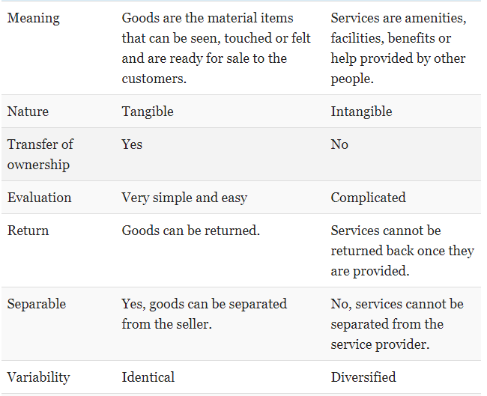
Comparison Goods and Services

Slide 10
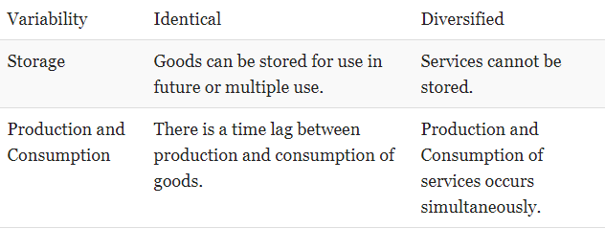

Slide 11
Classification of services by Industry
INDUSTRY Entertainment Industry Hospitality Industry Trading Finance and Insurance | SERVICES Movie/ Television programes Amusement Services Hotels and lodging places Restaurants and cafes Food catering and event organization Wholesale trade Retail Trade Online Trade Loans and Advances Credit cards Banking Investment ,brokerage and advices

Slide 12
e) Education f) Transportation g) Public Utilities h) Government Services | v) Real Estate vi) Consultancy Services Such as Credit ratings School, colleges etc. Training and consultancy i)Air, sea , road and Train travel ii) Car hire, charter and leasing iii) Goods transport by all means iv) Pipelines v) Mail and courier Services Electricity Supply Water Supply Drainage and sewerage Garbage collection and disposal Defense Police and protection Health and Education Foreign Relations

Slide 13
Health j) Business Services k) Telecommunication | Hospitals and Clinics Gymnasium and spa De-addiction programs i) Cleaning ii) Catering iii) Security iv) Training Telephone , e-mail Data transfer Mobiles Video conferencing

Slide 14
Importance of Marketing of Services
A key differentiator:
Due to the increasing homogeneity in product offerings, the attendant services provided are emerging as a key differentiator in the mind of the consumers. Eg: In case of two fast food chains serving a similar product (Pizza Hut and Domino’s), more than the product it is the service quality that distinguishes the two brands from each other. Hence, marketers can leverage on the service offering to differentiate themselves from the competition and attract consumers.

Slide 15
Importance of relationships
Relationships are a key factor when it comes to the marketing of services. Since the product is intangible, a large part of the customers’ buying decision will depend on the degree to which he trusts the seller. Hence, the need to listen to the needs of the customer and fulfill them through the appropriate service offering and build a long lasting relationship which would lead to repeat sales and positive word of mouth.

Slide 16
Customer Retention
Given today’s highly competitive scenario where multiple providers are vying for a limited pool of customers, retaining customers is even more important than attracting new ones. Since services are usually generated and consumed at the same time, they actually involve the customer in service delivery process by taking into consideration his requirements and feedback. Thus they offer greater scope for customization according to customer requirements thus offering increased satisfaction leading to higher customer retention.

Slide 17
OVERVIEW-INDIAN SERVICE SECTOR
India stands out from other emerging economies because its growth has been led by the service sector.
The Sector constitutes a large part of the Indian economy both in terms of employment potential and its contribution to national income
The services sector contributes more than half of the GDP in India.
The sector covers a wide range of activities.

Slide 18
THANK YOU

Slide 19
Service Marketing Mix
The essence of every marketing strategy is the marketing mix. For service marketing , due to special and unique features the marketing mix is extended to include physical evidence , process and people. Thus marketing mix of service are
Product
Price
Place
Promotion
People
Process
Physical Evidence

Slide 20
Product
Product (i.e. Service ) refers to the activities that a marketer offers to perform , which results in satisfaction of a need or want of the target customer. Planning for service product in many ways similar to the planning of tangible goods, although establishing the nature of service is difficult. The service product consists of core product –which is the primary benefit the customers seek from the service and peripheral services that are secondary benefits the customer seek.

Slide 21
The management often tries to integrate core and peripheral services into a competitive strategy. e.g. Accounting firms have added management consultancy to their traditional core offerings of accounting service. Moreover , since services are intangible the service marketers must tangibles the intangible aspect. Superior quality , trusted brand image , extended guarantees , courteous staff , prompt service all from the part of managing the service offering.

Slide 22
Price
The price of the service is the value attached to it by service provider and this must correspond with the customer’s perception of the value . Service pricing decision are made in more varied environment than product pricing decisions. Demand for service tend to be less elastic than for goods , meaning that , as prices rise the consumption of the service will not decrease as fast as goods. The methods of pricing for services can not be scientific as those for products. Demand oriented method is difficult because of the uncertainty in projecting service demand . Cost oriented method is more common but this is also difficult to implement because it is hard determine the cost of people based services. In some cases competitor based pricing may be suitable, where the service is price sensitive, for example pricing airlines . Whatever the method of price determination, the price of service usually influences image . Since services are more ambiguous than goods , consumers are likely to associate the price of a service with quality.

Slide 23
Place
The place decision refers to the ease of access that potential customers have to a service. They can , therefore , involve physical location decision-e.g. Where to place a hotel, decision about what intermediary to use in making a service accessible to a customer-e.g. Whether a tour operator uses a travel agent or sells it holiday package directly to the customers.

Slide 24
Promotion
Promotion is used to communicate information about goods and services to target market audience .There is a need to make services more tangible by linking them to objects in promotion. Another important objective of service promotion is to reduce the risk of buying service. The traditional promotion mix include various methods of communicating the benefits of a service to potential consumers or advertising ,sales promotion , personal selling and public relations .

Slide 25
People
In any service , it is people who play a vital role in the service encounter. This includes both employees and other customers. The attitudes and action of the employees can certainly affect the success of service encounter. It is also likely that the behavior of other customers , in a movie theatre, restaurant or class room can affect an individual service experience.

Slide 26
Process
The important objective of marketing is to identify the needs and wants in the market place so that the service may be designed to fulfill these needs. This include the design of the service process and how the service is delivered .Ultimately , it reflects how all the marketing mix elements are coordinated to provide consistent and quality service to the customer.

Slide 27
Physical Evidence
Services are intangible. But they are often provided along with many tangible elements. Physical evidence includes the environment/place where the service is provided and any tangible elements that facilitate the performance or communication of the service. It’s the tangible part which is more or less complementary to the service. For example, a physical evidence mix of a premium saloon will include the staff’s uniform, a good ambience created by playing nice music and spraying good room freshener, etc

Slide 28
Importance of marketing mix
PRODUCT
Product determines the company ability. Therefore, product strategy and product policy plays very important role for organization and the decision for the product.
Second, determinant of marketing mix is product as it has affect on distribution, pricing and advertising. Therefore, it is important that company has to follow proper policy.

Slide 29
PRICE
Seeking in market
Covering cost
Price which generates profit
Competitive products
Customers benefit
Therefore, deciding the price of a product is very important. There is some points that should be considered. These are, what the product is and the worth to the customer. Another point is that being aware of the cost to produce and also cost of competitor.

Slide 30
PLACE
Place is important as it decides the reach of the product. There is some factors to be followed for the strategies. The first factor is that seeking for the best distribution channel. The second factor is that having significant premises for the customers. And final factor is that being aware of the if the response is whether quick at the reasonable cost or not.

Slide 31
PROMOTION
Strategies has to be consider some factors to gain competitive advantage. Product improvement has to be advertised and should maintain the preference.

Slide 32
PEOPLE
having the appropriate staff and people is important factor for any service provision. In order to get competitive advantage for the organisation, it is important the hiring the right employee and training them. Because consumers make judgements about the service based on the staff`s behaviour. Thus, employees should have the interpersonal skills and service knowledge.

Slide 33
PROCESS
The marketer has to plan the process of service deliver carefully, and plan what quality controls can be built in to make sure that customers are confident that about to expect each time they use the service product.

Slide 34
PHYSICAL EVIDENCE
Physical evidence is very important factor for service mix as the consumers make perceptions based on their sight of the service provision which will have an impact on the organizations perceptual plan of the service.

